Slide 1

Retail Database
To provide a database to help startup retail companies compete with other larger retail companies by providing them with an application to compare and visualize their data
Notes:
Pic from: https://www.google.com/url?sa=i&url=https%3A%2F%2Fwww.aislelabs.com%2Fblog%2F2018%2F10%2F10%2Fcustomer-paths-and-retail-store-layout-part-5%2F&psig=AOvVaw3Nm0h__zfQoqKsjpXijWOl&ust=1589537977313000&source=images&cd=vfe&ved=0CAIQjRxqFwoTCKiHitOQs-kCFQAAAAAdAAAAABAI

Slide 2
Why we chose this topic
To create a database that can be used by businesses to help marketing, customer service, and shopping trends
To explore the details and benefits of implementing an online retail database application.
To discover the benefits of utilizing databases in the competitive retail industry

Slide 3
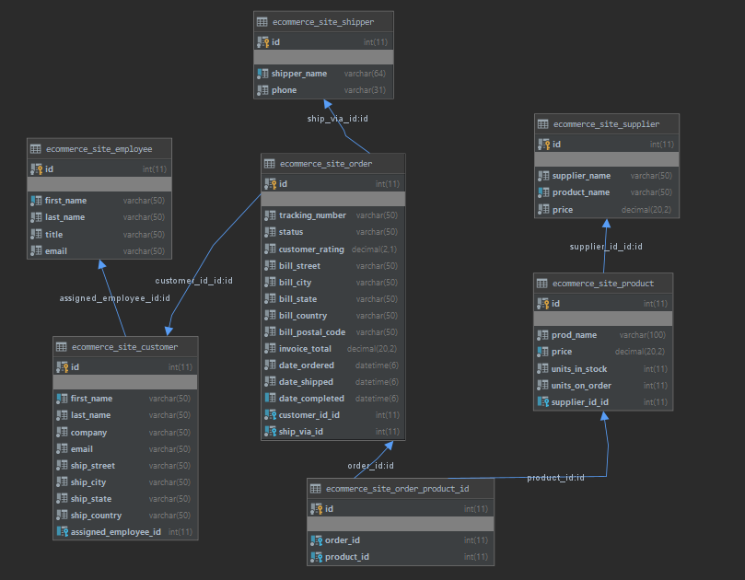
Schema

Slide 4
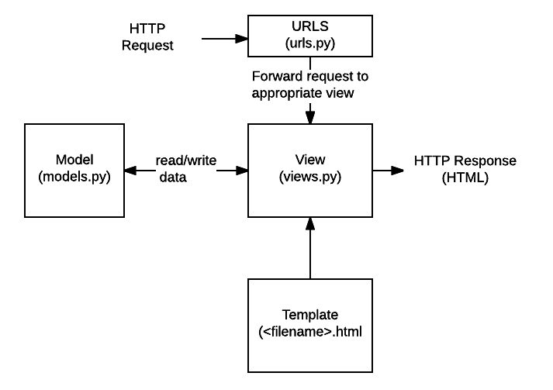
Django
What is it?
Part of our solution to utilize available technologies to provide a web front-end
A Python Web Framework that uses Model-View-Template Data Flow

Slide 5
Django
Why use it?
Well Documented
Batteries included
Administration
Security Features
Flexible integration of other technologies

Slide 6
Features Implemented
Data Visualization Page
Using Chart.js
Report Generation
CRUD / Filtered Queries
Demo Time

Slide 7
Planned Progress
Report Generation for session activity (user tracking)
Additional options for Parameterized queries
Optimize page load, query response time
Result pagination

